Slide 1

CSE 8A – Introduction to Programming and Computational Problem Solving I
Files and Data Science
How to get help:
Class Website
https://sites.google.com/ucsd.edu/cse8afa23/home
Piazza for brief questions or logistic questions
Tutor Hours for help with homework/setting up computer To get help, use Autograder (directions on piazza)
Office Hours for homework/conceptual help
Slides based, in part, on materials from Dan Zingaro.
Notes:
Welcome!

Slide 2
Lists review to warm up
songs = [['Aladdin', ' Friend Like Me', ' 8'],
['Beauty and the Beast', ' Gaston', ' 2'],
['Moana', " How Far I'll Go", ' 9'],
['The Little Mermaid', ' Poor Unfortunate Souls', '6']]
What does len(songs) return?
1
3
4
12

Slide 3
Lists review to warm up
songs = [['Aladdin', ' Friend Like Me', ' 8'],
['Beauty and the Beast', ' Gaston', ' 2'],
['Moana', " How Far I'll Go", ' 9'],
['The Little Mermaid', ' Poor Unfortunate Souls', '6']]
Which expression evaluates to 'Moana'?
songs[2]
songs[0]
songs[0][2]
songs[2][0]
songs[2][0][0]

Slide 4
Announcements
Reading Quiz 6 is due Tuesday at noon
Homework 4 due Monday at 10pm
Quiz 2 is in lab next week. Topics:
Loops, Strings, Lists
Reading files, basics of analyzing data
~30 minutes will be similar to quiz 1
~15 minutes will be a coding activity where you will have access to Copilot and need to solve a problem.
Project 1!
Find an analyze a dataset. More details in the project description.

Slide 5
Learning Goals for Today
By the end of today’s lecture, you should be able to:
Read text files
Find a dataset online in Kaggle for your project
Use csv package to read a csv into a 2D list
Use Python to perform basic analysis on the 2D list

Slide 6
Reading Files
What is a file? What do different types of files mean?

Slide 7
Text Files
So far, many of our programs have retrieved data from the keyboard and written data to the screen
Data must be entered on every program run
Programs have no way to permanently store results
Text files provide convenient input/output storage
e.g. programs can read input data from one file and store the results in another file

Slide 8
Text Files
A program is designed to retrieve some data from a file, process it, and output the revised data to another file. Which of the following will not be used in the program?
A. open
B. something for reading (e.g., read, or a for-loop)
C. write
D. close
E. All of the above should be used
Notes:
Short question to introduce the flow. Open a file for reading. In this example, open a file for writing. Read one file, perform some analysis, write to another file, close the files.

Slide 9
Reading Files with Methods
To read the next line from a file:
readline: reads and returns next line; returns empty string at end-of-file
There are other reading methods, but they read the entire file into memory all at once
Only use these if you really do need access to the entire file and not e.g. just the current line
read: reads the entire file into one string
readlines: reads the entire file into a list of strings
All of these leave a trailing '\n' character at the end of each line.

Slide 10
Reading Files with Loops
A (text) file is a sequence of lines:
f = open("songs.txt")
for line in f:
print(line.strip())
…or using a while-loop:
f = open("songs.txt")
line = f.readline()
while line:
print(line.strip())
line = f.readline()
Notes:
Talk through how either will print all the lines in the file. The test “while line” checks whether there’s a line that has been read.

Slide 11
Reading Files with Loops
def skip(f):
line = f.readline()
line = f.readline()
while line.startswith('#'):
line = f.readline()
return line
f refers to the file songs.txt and has just been opened. What does skip(f) return?
Here are the first few lines of songs.txt:
Movie Songs and Ratings
# These are Leo's ratings
# Visit Leo in office hours to discuss
Aladdin, Friend Like Me, 8
Beauty and the Beast, Gaston, 2
Moana, How Far I'll Go, 9
A. The first line
B. The second line
C. The third line
D. The fourth line
E. The fifth line
Notes:
Talk through how many lines are read and how this returns the 4th line

Slide 12
Multi-Field Records
So far, we have been reading entire lines from our file
But, our lines are actually records containing three fields:
movie name, song name, and song rating
We could write a function to read this data into three lists (good take home exercise!)
However, this file is actually a csv
CSV stands for comma-separated value
There are libraries to manage csv files (recall end of Chapter 2)
CSV files often end in .csv (rather than .txt)

Slide 13
Opening using csv module
import csv
data = list(csv.reader(open("songs.csv")))
print(data)
Output:
[['Movie', ' Song', ' Rating'], ['Aladdin', ' Friend Like Me', ' 8'], ['Beauty and the Beast', ' Gaston', ' 2’], ['Moana', " How Far I'll Go", ' 9’]]
Notice, data stores a list of lists!
Here are the contents of songs.csv:
Movie, Song, Rating
Aladdin, Friend Like Me, 8
Beauty and the Beast, Gaston, 2
Moana, How Far I'll Go, 9

Slide 14
Accessing an element
Here are the contents of songs.csv:
Movie, Song, Rating
Aladdin, Friend Like Me, 8
Beauty and the Beast, Gaston, 2
Moana, How Far I'll Go, 9
import csv
data = list(csv.reader(open("songs.csv")))
print(data)
Output:
[['Movie', ' Song', ' Rating'], ['Aladdin', ' Friend Like Me', ' 8'], ['Beauty and the Beast', ' Gaston', ' 2’], ['Moana', " How Far I'll Go", ' 9’]]
Which of the following would give you ' 8'?
A. data[1][2]
B. data[2][3]
C. data[2][1]
D. data[3][2]
E. None of the above
Notes:
A. Could draw with indexes to help.

Slide 15
How to average the ratings?
Here are the contents of songs.csv:
Movie, Song, Rating
Aladdin, Friend Like Me, 8
Beauty and the Beast, Gaston, 2
Moana, How Far I'll Go, 9
import csv
data = list(csv.reader(open("songs.csv")))
<Insert Code here>
Fill in the code below to compute the average of the ratings in the file:
sum = 0
count = 0
for row in range(_____,_______):
sum = ___________ + sum
count = count + 1
print(_____ / ______)
Practice for home, can you create a program that will print the contents of data back as the original CSV file?
Notes:
sum = 0
count = 0
for row in range(1,len(data)):
sum = int(data[row][2]) + sum
count = count + 1
print(sum / count)
Careful on the conversion to int, the file is read in as strings

Slide 16
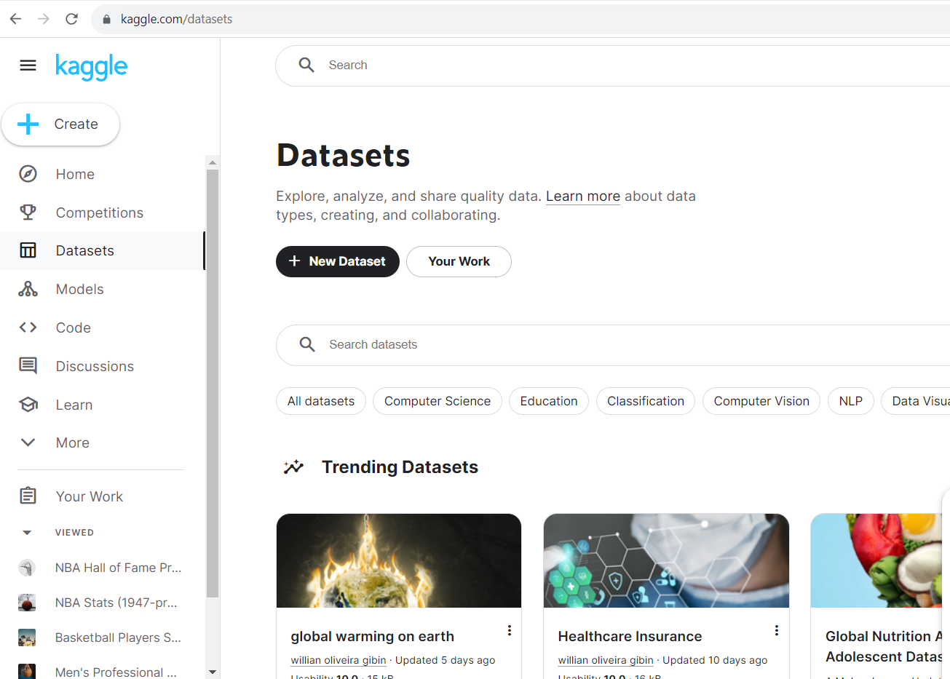
Project 1
Individual Project
Find a dataset on Kaggle that is interesting to you
Ask questions of the data
Break up the problem
Solve using code+Copilot
Can get help, but no using existing answers
To be turned in:
Working Code
Function diagram (the functions you made)
Video
Video Contents
Why this dataset, what you asked, what you found
Walkthrough of how a function in your code works.

Slide 17
Project 1
Checkpoint due in 1 week (due end of tutor hours Thursday):
Talk to a tutor to get points for checkpoint. You will need to tell them:
What dataset you’ve selected
What you are asking from the data
Show some code where you’ve at least opened the file and can print some of its contents.
Don’t wait for the last minute! Tutor’s will work first-come, first-serve and if everyone waits for Thursday, you won’t get your checkpoint points.
Worth 5% of the project grade. Bonus 1% if you complete the check by end of tutor hours Tuesday.
Individual Project
Find a dataset on Kaggle that is interesting to you
Ask questions of the data
Break up the problem
Solve using code+Copilot
Can get help, but no using existing answers
To be turned in:
Working Code
Function diagram (the functions you made)
Video
Video Contents
Why this dataset, what you asked, what you found
Walkthrough of how a function in your code works.

Slide 18
Step 1, Find a dataset!
Go to Kaggle.com (make an account, it’s free)
Explore the datasets
Be sure all the data you need is in one csv file
Careful, sometimes to do an analysis, you need to merge multiple csv files and that’s beyond the scope of this project
It’s okay if the dataset has more than one csv file so long as you can get what you need from a single csv
Notes:
Demo going on Kaggle and finding a dataset. We’re going to use this one for the rest of the demo
https://www.kaggle.com/datasets/asaniczka/usa-wage-comparison-for-college-vs-high-school

Slide 19
Step 2, Ask interesting questions
Using our college_wage_premium.csv
Our two questions for today:
How much greater is the average college wage than the average high school wage in the dataset?
Has the gap in wages grown or gotten smaller when comparing the timeframes of 1973-2000 and 2000-2022
Note, these are good starter questions for a project, but we’d be looking for more in your project. For example, you might add:
How has the gap in male/female wages changed over time and how has gender impacted that gap?
Notes:
Talk about asking good questions of the data and how you’ll want to be able to say something interesting by the end of the project

Slide 20
Step 3 – Break into function (if possible)
Question: How much greater is the average college wage than the average high school wage in the dataset?
What are the necessary sub-tasks to solve this problem? Which of the following methods would be most useful for us to implement?
findAverageOfColumn(dataset, column_num) – Takes a list of lists representing the data file, and the index of a column in the data set, and returns the average of that column's values.
getColumn(dataset, column_num) – Takes a list of lists representing the data file and the index of a column in the data set and returns the values in that column as a list.
Both would be useful

Slide 21
Step 3 – Break into function (if possible)
Let’s load in the data, then call helper functions
How much greater is the average college wage than the average high school wage in the dataset?
Let’s create a function that can give us the average of a column excluding the header row. We could give it the index of the column as input (or possibly the header name of the column)
Better, we could have it return a list of the values so we could compute min, max, average, etc.!
Has the gap in wages grown or gotten smaller when comparing the timeframes of 1973-2000 and 2000-2022
Let’s create a function that can give us the average of a column over a time range specified
Better, we could have it return a list of the values so we could compute min, max, average, etc.!

Slide 22
First function (group activity)
Let’s create a function that can give us the average of a column excluding the header row. We could give it the index of the column as input (or possibly the header name of the column). Bonus, let’s return the list of the data (if time).
Notes:
After they try to code this in groups, ask how well it went (did they get to an answer, etc.) (I like using a quick clicker question to ask how far their group got.)
Copilot is likely to give a list slicing answer, you can have them look that up or talk about it briefly.
My prompt:
def average_wage(data, column):
""" input is a 2D list called data with a header row
and a column name that matches a column in the header
return the average of the values in that column excluding
the header"""
Copilot reply (which is correct):
# find the index of the column name
index = data[0].index(column)
# initialize a sum variable to 0
sum = 0
# loop through the data starting at row 1
for row in data[1:]:
# add the value in the column to the sum
sum += float(row[index])
# return the average
return sum/(len(data)-1)

Slide 23
Different answers
Notes:
Just here if you want to talk through some other answers.

Slide 24
Testing with files (section 6.6 in the book)
Don’t just trust the answer from Copilot!
You have options when writing test cases, when working with files:
(Preferred) Create artificial data as a 2D list (no files needed) and test your functions on that data.
(Also preferred!) Create a small subset of the data in the file, determine answers manually, and run tests on those answers.
(Not ideal) Figure out the answer for the larger dataset using other software (e.g., Google sheets). Problem here is it begs the question of why you are coding it in the first place (and some of these datasets are going to be slow to process in sheets or excel).
Notes:
Talk through pros and cons of each. 1 is best to get started, then 2 is good to make sure the file is read in properly (could have special characters in the actual data that cause problems, etc.)

Slide 25
Second function (group activity)
Let’s create a function that can give us the average of a column over a time range specified. Input is the data, the column, and data range.
Notes:
If time, let them do this as an activity. If short on time, just live code with them.
def average_wage_over_range(data, column, year_start, year_end):
"""
input is a 2D list called data with a header row and a column
name that matches a column in the header. The first column is
the year the data was collected. year_start through year_end
(inclusive) specify the years we want included in the data.
return the average of the values in that column over the specified
year range excluding the header
"""
# find the index of the column name
index = data[0].index(column)
# initialize a sum variable to 0
sum = 0
# initialize a count variable to 0
count = 0
# loop through the data starting at row 1
for row in data[1:]:
# if the year is in the range
if int(row[0]) >= year_start and int(row[0]) <= year_end:
# add the value in the column to the sum
sum += float(row[index])
# increment the count
count += 1
# return the average
return sum/count

Slide 26
Summary
Files allow us to read and store data
The csv module helps us analyze csv files
Using the csv module on public data sources allows us to learn and draw conclusions about the data
Notes:
Mention extension

